Slide 1
Sport Meeting Management Database
119010321 Wang Yuhao / 119010322 Wang Yupeng /
119010054 Dai Yulong / 119010249 Qin Peiran /
119010344 Xiao Nan

Slide 2

Contents
01
Introduction
02
ER-diagram & Relational Schema & Normalization
03
SQL Queries
04
Web Demo
05
Data Analytics

Slide 3
Introduction
First LGU track-and-field sports meeting ?
...This management database is designed for a particular sports meeting

Slide 4
Introduction
Player:
register
sign up
search event information
Org Comm:
initialize (events, number of rounds/breaking players, volunteers, referees, fields)
update event results
search event information

Slide 5
02
ER-diagram & Relational Schema & Normalization

Slide 6
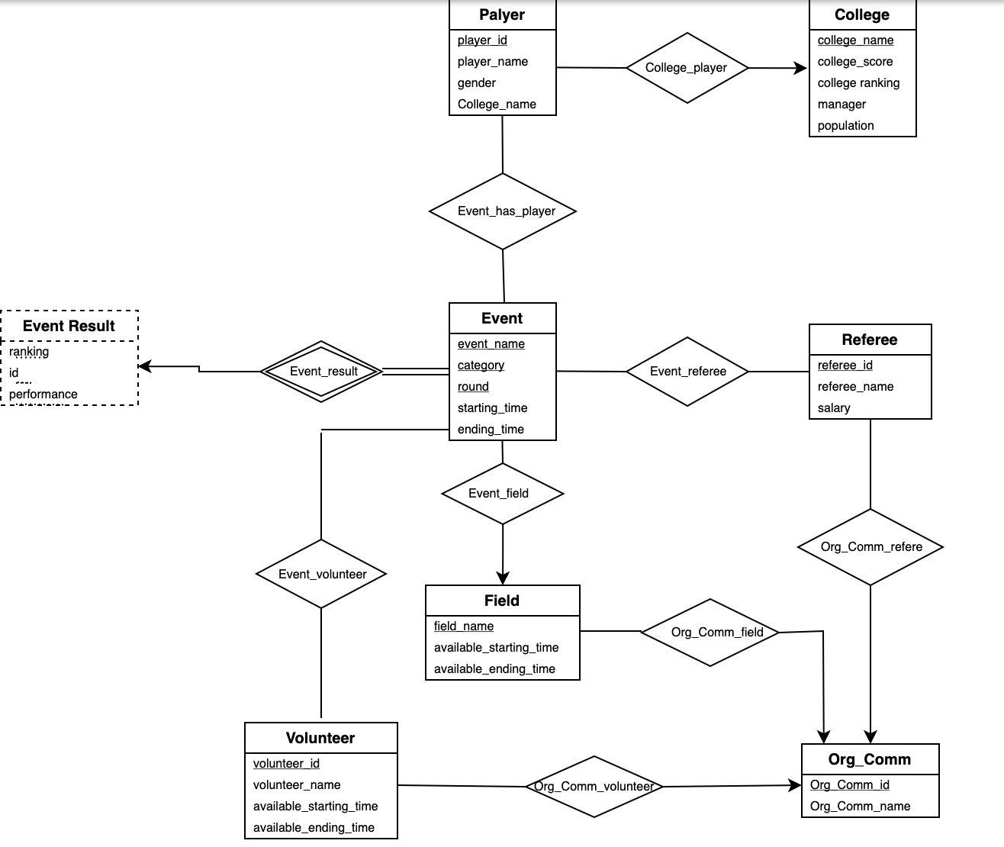
ER-diagram

Slide 7
Schemas
player (Player_id, Player_name, Gender, College_name)
college (College_name, College_score, College_ranking, Manager, Population)
event (Event_name, Category, Round, Starting_time, Ending_time)
event_has_player (Event_name, Category, Round, Player_id)
event_result (Event_name, Category, Round, ranking, id, performance)
volunteer (Volunteer_id, Volunteer_name, available_starting_time, available_ending_time)
volunteer_has_event (Volunteer_id, Event_name, Category, Round)
org_comm (Org_comm_id, Org_comm_name)
field (Field_name, Available_starting_time, Available_ending_time, Org_comm)
referee(Referee_id, referee_name, salary, Org_comm_id)
event_has_Referee (Event_name, Category, Round, Referee_id)

Slide 8
Normalization (1)
Multi-value
volunteer (Volunteer_id, Volunteer_name, Available_starting_time, Available_ending_time)
field (Field_name, Available_starting_time, Available_ending_time, Org_comm)
volunteer_name(Volunteer_id, Volunteer_name)
volunteer_time (Volunteer_id, Available_starting_time, Available_ending_time)
field_time (Field_name, Available_starting_time, Available_ending_time)
field_org (Field_name, Org_comm)

Slide 9
Normalization (2)
Transitive
college (College_name, College_score, College_ranking, Manager)
college (College_name, College_score, College_ranking, Manager)
college_rank (College_score, College_ranking)

Slide 10
Schemas in 3NF
player (Player_id, Player_name, Gender, College_name)
college (College_name, College_score, College_ranking, Manager)
college_rank (College_score, College_ranking)
volunteer_name(Volunteer_id, Volunteer_name)
volunteer_time (Volunteer_id, Available_starting_time, Available_ending_time)
event (Event_name, Category, Round, Starting_time, Ending_time)
event_has_player (Event_name, Category, Round, Player_id)
event_result (Event_name, Category, Round, ranking, id, performance)
volunteer_has_event (Volunteer_id, Event_name, Category, Round)
org_comm (Org_comm_id, Org_comm_name)
field_time (Field_name, Available_starting_time, Available_ending_time)
field_org (Field_name, Org_comm)
event_has_Referee (Event_name, Category, Round, Referee_id)

Slide 11
03
SQL Queries

Slide 12
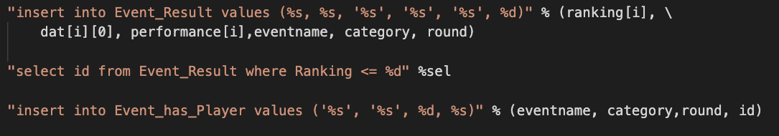
SQL Queries (1)
1. Qualify the players into the next round

Slide 13
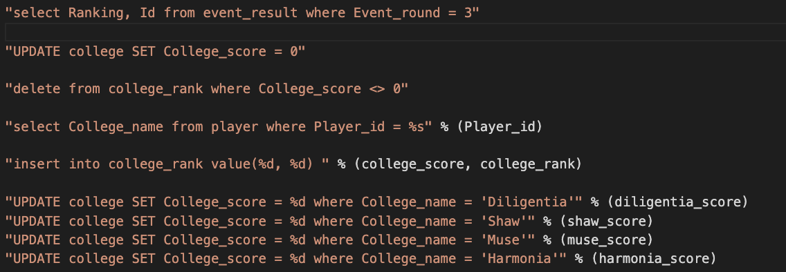
SQL Queries (2)
2. Update college ranking automatically

Slide 14
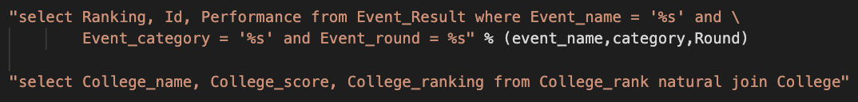
SQL Queries (3)
3. Search the results of a certain event
4. Get the ranking of colleges

Slide 15
04
Web Demo

Slide 16






Front End
Back End

Slide 17
DEMO

Slide 18
05
Data Analytics:
Estimation of college engagement in the sport’s festival

Slide 19
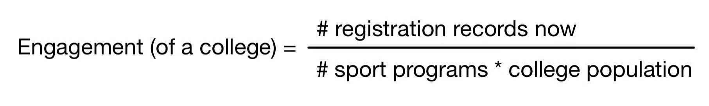
Engagement
Intuitively:
defective

Slide 20
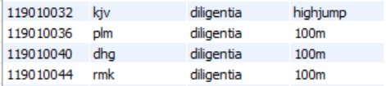
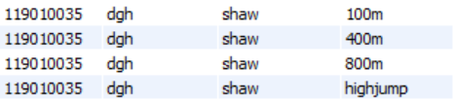
Engagement
Same # registration records.
Engagement_rate_1 = Engagement_rate_2 (in previous criteria)
-> Equally engaged.
A college manager would prefer the first since it involves more students.

Slide 21
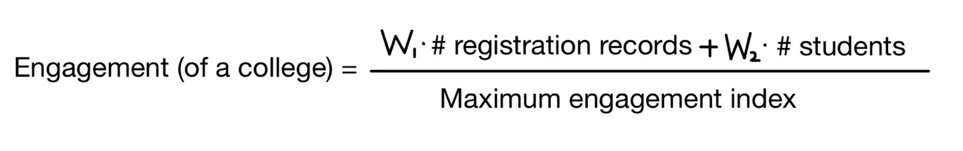
Engagement
Assuming that the ratio of importance between # records and # students is 7/3 approximately.
Large engagement => Effective participation.
Low engagement => Requirement of encouragement.

Slide 22
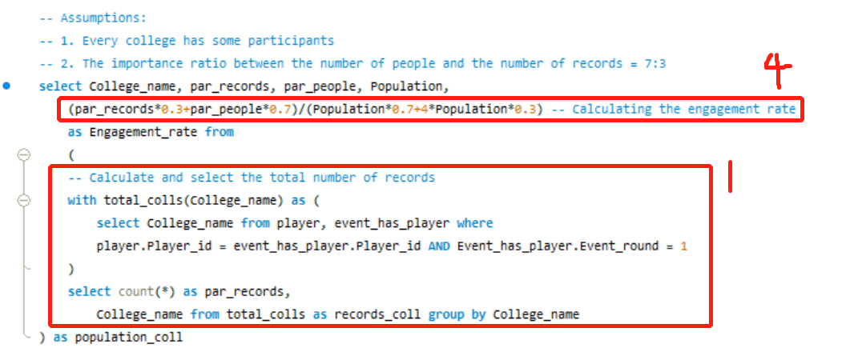
Engagement
Implementation:

Slide 23
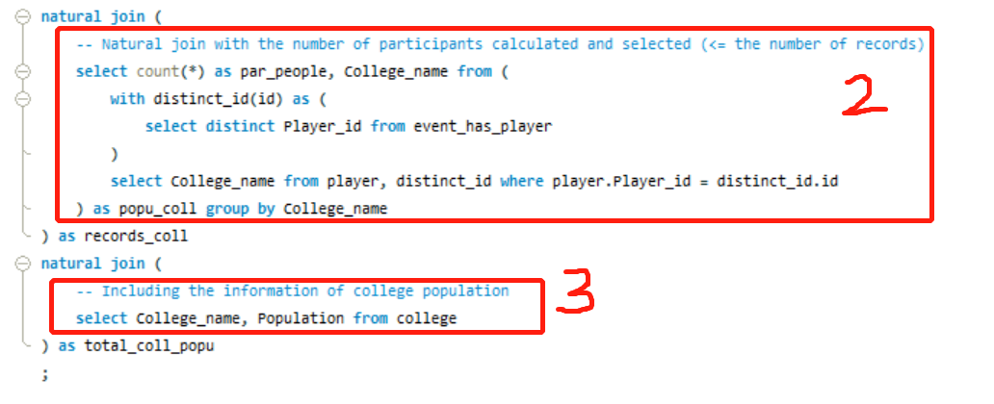
Engagement
Implementation:

Slide 24
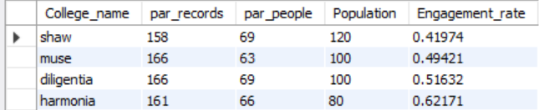
Engagement
Sample results:

Slide 25
Thank you!

